Slide 1
CS 4530: Fundamentals of Software Engineering Lesson 5.1 Cloud Infrastructure
Rob Simmons
Khoury College of Computer Sciences

Slide 2
Learning objectives for this lesson
By the end of this lesson, you should be able to…
Explain what “cloud” computing is and why it is important
Explain why shared infrastructure is important in cloud computing
Discuss trade-offs that you might consider for self or vendor-managed platforms
Notes:
<read slide>

Slide 3
Old school
Data centers were the original shared infrastructure
Save on physical costs (power, cooling, security)
More cost-effective reliable network connections
user
Data center
Internet
AOL?
My web server that I bought

Slide 4
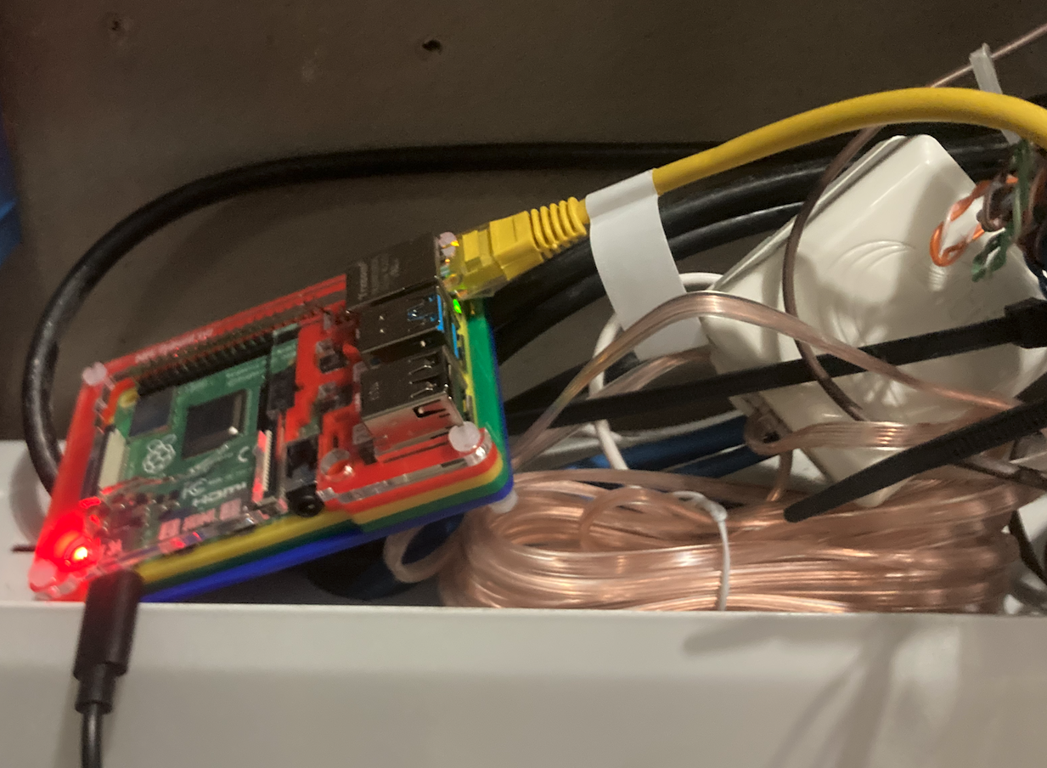
Old school
user
Data center
Internet
AOL?
My web server that I bought
Verizon?
Comcast
Internet
Problems:
IP address not stable
Comcast might get mad?
The raspberry pi in my utility closet in Jamacia Plain

Slide 5

Old school
user
Data center
Internet
AOL?
My web server that I bought
Verizon?
“tunnel”
IDK
Internet
Some computers and
networks somewhere
that cloudflare runs, idk
Also handles HTTPS certificates
The raspberry pi in my utility closet in Jamacia Plain

Slide 6



Old school problems
Servers were (are?) expensive
Being in a different place than your server is annoying
Very hard to respond to changes in demand
My web server that I bought
The raspberry pi in my utility closet in Jamacia Plain

Slide 7
Infrastructure as a Service (IaaS)
Let the people running the data center handle the physical computers (purchasing, maintaining, replacing)
Required new software and systems, especially virtualization which lets you run multiple independent operating systems on one computer (mid-2000s)
Linode and DigitalOcean in 2003, Amazon’s Elastic Compute Cloud (EC2) launches in 2006
Fast (minutes/hours not days/weeks) to get more capacity

Slide 8
Platform as a Service (PaaS)
Amazon Web Services launched with three products:
EC2 — virtual machine hosting is infrastructure as a service.
Simple Queue Service (SQS) handled the problem of needing to do too many things at once (oversimplification: avoid running out of memory)
Simple Storage Service (S3) handled the problem of needing to store and deliver “static” data (oversimplification: avoid running out of disk space and/or network capacity)
SQS and S3 are “platforms” or basic capabilities
Typically very fast (minutes or fractions of a second) to get more capacity

Slide 9
Example: my Mastodon instance
DigitalOcean
“Spaces” (object storage)
Internet
Redis (for work queue)
Virtual
Machine
Postgres (for long term storage)
Infrastructure as a Service
Platform as a Service

Slide 10
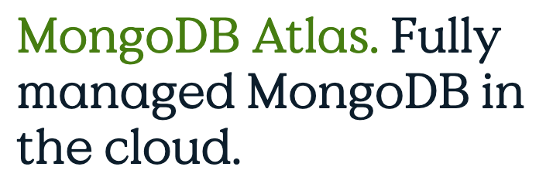
X as a Service
Infrastructure as a Service — bring-your-own-operating-system, but don’t worry about the hardware
Platform as a Service — hello, here’s a microservice or database or file storage location for you to use
Software as a Service — here’s Microsoft Word on the internet for you to use
Gray areas exist — are MongoDB Atlas and other DBaaS services PaaS or Saas? — but useful distinctions in practice.

Slide 11
Cloud Infrastructure is best for variable workloads
Consider:
Does your workload benefit from ability to scale up or down?
Variable workloads have different demands over time (most common)
Constant workloads require sustained resources (less common)
Example:
Need to run 300 VMs, each 4 vCPUs, 16GB RAM
Private cloud:
Dell PowerEdge Pricing (AMD EPYC 64 core CPUs)
7 servers, each 128 cores, 512GB RAM, 3 TB storage = $162,104
Public cloud:
Amazon EC2 Pricing (M7a.xlarge instances, $0.153/VM-hour)
10 VMs for 1 year + 290 VMs for 1 month: $45,792.90
300 VMs for 1 year: $402,084.00
Notes:
Cloud infrastructure makes sense when you expect the need to be able to scale up and down, and where the amount that you need to scale by is larger than your normal capacity needed.
For example: imagine that we are building a system that needs to be able to scale up in resources to go up to using 300 VMs, each with 4 CPUs and 16 GB RAM.
(Click) If we are buying hardware ourselves for this, we might buy something like these Dell PowerEdge servers, each with 128 cores and 512GB RAM, giving us enough capacity to scale up to 300 VMs (plus some extra CPUs + RAM for managing this whole cluster). In July 2021 this cost $162,104.
What would this cost for a year if we went to Amazon? (Click) We could get virtual machines at $0.121/hour. If our baseline infrastructure requirement was just to have 10 VMs for the year, and we projected that only at peak loads we would need to scale up (to say, another 290 VMs for 1 month), the total cost at the end of the year would be $36,215.30. We would definitely save some cash compared to the self-hosted option (plus the hassle of procuring and managing that cluster).
But: what if we needed all 300 VMs for the entire year? Using EC2 this would cost $317,988 - nearly twice the cost of the self-managed option (and it’s just for one year! Once you buy the servers they will last for hopefully quite a few years!).
Self-managing a cluster like this requires a place to put them, power, and cooling - plus the administration of the software. (this dell cluster draws up to 90 amps of power, which is roughly half of the power that typically service as a house).
(The EC2 pricing was taken on Feb 19, 2024. The pricing includes the discount that you would receive for guaranteeing a year of compute time per-VM.
Dell pricing from July 2021, includes enterprise discount for Northeastern
The astute reader will note that amazon gives you 4 “vCPUs” which means 2 physical CPU cores, each of which are hyper threaded. The 7 x 128c option gives you a few extra cores to spare)

Slide 12
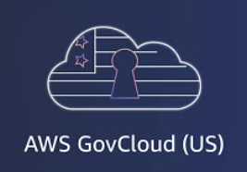


Public clouds are not the only option
“Public” clouds are connected to the internet and available for anyone to use
Examples: Amazon, Azure, Google Cloud, DigitalOcean
“Private” clouds use cloud technologies with on-premises, self-managed hardware
Cost-effective when a large scale of baseline resources are needed
Example management software: OpenStack, VMWare, Proxmox, Kubernetes
“Hybrid” clouds integrate private and public (or multiple public) clouds
Effective approach to “burst” capacity from private cloud to public cloud
Remember to think about your threat model
https://www.csis.org/analysis/cloud-act-and-transatlantic-trust
Notes:
As we saw on the last slide, public clouds may not be the most cost-effective option when a workload has a high baseline resource requirement - like needing to have 300 x 4 core VMs running all of the time.
(Read slide)
A “hybrid” cloud option could prefer to consume resources from our on-premises resource, only “bursting” to use public cloud services when the private cloud reaches a capacity threshold

Slide 13
“X as a Service" offers several abstractions to choose from depending on your needs
Vendor manages different levels of the stack, achieving economies of scale
When would you choose one over the other?
Explore some options at https://comparecloud.in/
Application
Application
Application
Application
Middleware
Middleware
Middleware
Middleware
Operating System
Operating System
Operating System
Operating System
Virtualization
Virtualization
Virtualization
Virtualization
Physical Server
Physical Server
Physical Server
Physical Server
Storage
Storage
Storage
Storage
Network
Network
Network
Network
Physical data center
Physical data center
Physical data center
Physical data center
Traditional, on-premises computing
IaaS
PaaS
SaaS
Self-managed
Vendor-managed
Notes:
<read slide>

Slide 14
Learning objectives for this lesson
By the end of this lesson, you should be able to…
Explain what “cloud” computing is and why it is important
Explain why shared infrastructure is important in cloud computing
Discuss trade-offs that you might consider for self or vendor-managed platforms
Notes:
<read slide>

